Slide 1
Recent Advances in Management if Infertility
SIG Endocrinology 2019
Chairperson – Madhuri Patil

Slide 2
The Rationale For Additional Advanced Technologies in ART?
Majority of
patients do not conceive after the 1st treatment
Most IVF failures occur after ET
Primarily related to embryo quality or
endometrial receptivity
Clinicians search for intervention that could improve either

Slide 3
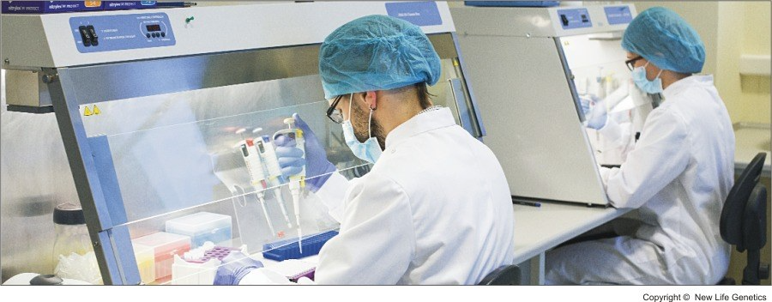
New Entrants in ART
Technology
Advanced methods of sperm selection IMSI, PICSI, MACS
Stem cell therapy
Time lapse
Three parent baby
Oocyte activation
Assisted Hatching
Uterine transplant

Slide 4
Advanced Sperm selection Methods Prior to ICSI
Physiological ICSI – (PICSI)
Mature sperm selection using Hyaluronan the natural biomarker for sperm quality
Intracytoplasmic Morphologically Selected Sperm Injection (IMSI)
Sperm separation using Sperm surface charge
Sperm head birefringence
Magnetic-activated cell sorting (MACS)
Electrophoretic separation and zeta potential
Selection based on Motile‐sperm organelle‐ morphology examination’(MSOME)
Mature sperm nucleus acrosome complex has strong intrinsic birefringence
Non-apoptotic sperm selection

Slide 5
PICSI IMSI Birefringence
1. low FR after ICSI
2.compromised embryo development in previous cycles
3. history of miscarriage
4. high sperm DFI
1. Increased number of morphologically abnormal sperms present
2. Identification of specific sperm organelles is required
Selection of morphologically normal and competent sperm

Slide 6
MACS + DGS Zeta Potential
Sperm samples with high DFI
Not useful in severe male factor fertility
Sperm suspension in a positively charged tube.
Negatively charged mature sperm (A) will adhere to the tube, while non-mature
sperm (B) will not adhere and are discarded

Slide 7
Evidence for using Advanced Sperm selection methods
No statistically significant association between advance sperm selection and
1.fertilization and cleavage rates
2.good-quality embryos
3.implantation rate
4.biochemical and clinical pregnancy rate
5.miscarriage rates
Numbers of patients assessed are limited, and most studies are underpowered to conclude on differences in CPRs and LBRs
One needs to investigate safety and efficacy aspects of advanced sperm selection methods before their widespread implementation in ART
Some of these technologies will be more applicable broadly, whereas others may suit only a specific subset of patients
No clear evidences published on their real efficacy I in improving CPR or LBR
Advantage
Lower rates of chromosomal aneuploidies
Lower rates of DNA damage
May improve ICSI outcome
Lower rates of early miscarriage

Slide 8
Objective technologies for embryo selection
8 cell Morula Blastocyst
Morphology
Non invasive
PGS
Invasive
Time Lapse
Non invasive
Blastocyst TE Biposy CCS
Kinetics of Embryo Development

Slide 9
Embryo biopsy + Pre-implantation Genetic Testing (PGD/PGS)
To increase clinical outcomes in IVF by transfer of Euploid embryos AMA
RIF,RPL,
Severe male factor
Single nucleotide polymorphism arrays (SNP arrays)
✗

Slide 10
Characteristics
8-12 h after ICSI
Performed where embryo biopsy is considered illegal
Detects only maternal anomalies-aneuploidies
30% of post-meiotic anomalies not detected
Montag et al. Fertil Steril 2013
PROS
More DNA: less no results
Less mosaicism: less error rate
No impact of embryo biopsy
Less embryos to test: lower cost
eSET possible
Frozen ET: better endometrial receptivity CONS
Not all embryos reach blasctocyst
Requires experience
Schoolcraft et al. Fertil Steril 2010
PROS
Worldwide experience
Enough time for fresh ET
Suitable for many patients
CONS
Less DNA
High rate of mosaicism
Less implantation
Harton et al. Hum Reprod 2011

Slide 11
Time-lapse parameters promise non-invasive embryo assessment
May benefit following patients: RIF, Unexplained poor embryo quality, Good embryos Day 2 – High fragmentation D3, Male factor patients – showing poor fertilization, POR

Slide 12
PGS Rubio, F&S (2017) ESTEEM data (ESHRE 2017)ASRM committee report; Fertility and Sterility Vol. 109, No. 3, March 2018
FISH and Day 3 Biopsy
Negative impact of Embryo biopsy on development 􏰈and outcome of IVF
Primary Outcome - LBR
PGS 2.0 - no increase perhaps fewer miscarriages
Time Lapse
Ciray et al., 2014, Hojnik et al., 2016; The Cochrane Collaboration, 2015
Perfect tool for studying and understanding early embryo cleavages.
Irregularities in cell cleavages can be detected and such embryos can be deselected
Embryo culture and light exposure safety needs to be evaluated
Secondary outcomes
More no transfer, less transfers
Less embryos cryopreserved
Higher implantation rate per embryo
No effect on time to pregnancy
High costs, Invasive procedure
Mosaicism – Discard normal embryos
Insufficient evidence
Poor predictor of IVF outcome as too many confounding factors influence the dynamics of embryo development
Currently no high-quality data to support its usefulness

Slide 13
Procedures to increase IRs
Assisted Hatching
Mechanical
Laser assisted
Embryo Glue (Hyaluronan)
Conflicting results though few – improved IR and CPR
Chemical using Acid Tyrode
Breach in the zona pellucida facilitates earlier and complete hatching
Safety and efficacy remain to be established
Insufficient evidence that AH improves LBR (Level C)

Slide 14
Assisted Oocyte Activation (AOA) in cases of Complete Fertilization Failure in previous cycles
Mechanical stimuli | Physical stimuli | Chemical stimuli
Vigorous aspiration CaCl2 injection | Electrical pulses | Strontium chloride Calcium ionophores
Indications
Prior IVF cycle have had failed
Low fertilization after ICSI
Globozoospermia
Vanden Meerschaut et al 2014

Slide 15
Assisted Hatching

Slide 16
Newer Interventions in Low prognosis
Accumulation of oocytes
Accumulation of embryos
Stem cell therapy
In Vitro Activation
Gamete Repair
Uterine Transplant
Gametes and embryos from stem cell
Still Experimental

Slide 17
Accumulation of Oocytes and Embryos
Some Evidence for
Accumulation of Oocyte
Cobo et al-RBM 2012
Increased
IR, FR, CPR
Decreased cancellation of ET
Accumulation of embryos
Hwang Kwon Gyn & Obs 2015
Increased CPR, LBR

Slide 18
Methods of Mitochondrial Replacement
Maternal spindle transfer – MST
Pronuclear transfer - PNT
Ooplasmic transfer - OT
Carry-over effects coupled with preferential replication of original mitochondria AND/OR heteroplasmy per se
Still Experimental

Slide 19
Uterine Transplant
Congenital malformations
Absent Uterus
MRKH
Prior hysterectomy
IU adhesions
Non functioning uterus
Exposure to radiation

Slide 20
Other Therapies
Stem Cell
Autologous CD133+ BMDSC for
thin endometrium
Asherman’s syndrome
Evedince scanty
Autologous peripheral blood – Platelet rich Plasma (PRP)
No evidence
Relatively low proliferation
Differentiation into specific cell types is low
Suppressor of immune response
Ovarian Fragmentation and In-vitro activation
Action via
Stimulation of AKT pathway
Disruption of Hippo signaling
HR 2016

Slide 21
Before we implement these new technologies important to
Determine cost effectiveness
Evidence for proven benefit
Are we causing any potential harm?
Long term follow up the children
Liability to accept advanced test and technology is often left to the patient by means of informed consent

